Slide 1


360 Degree MONITORING
TRIBE-O
Business Required Document [BRD]

Slide 2
TRIBE : O
BACKEND TEAM | DOCUMENTATION TEAM
PRASAD MOHAN DHUPKAR (CO-LEADER) | ABHAY SINGH BAJETA (LEADER)
OMKAR SAMBHAJI DAMAME | SUNITA KUMARI NAYAK
DEEPAK PANIGRAHI | SANTOSINI SATAPATHY
SUBHANGI SUBHADARSHINI NAYAK | SANTOSHINI NAIK
SIDDIK JAHANGIR ATTAR | BIDYUT RANJAN NAYAK
ABHIPSA SAMANTRA

Slide 3
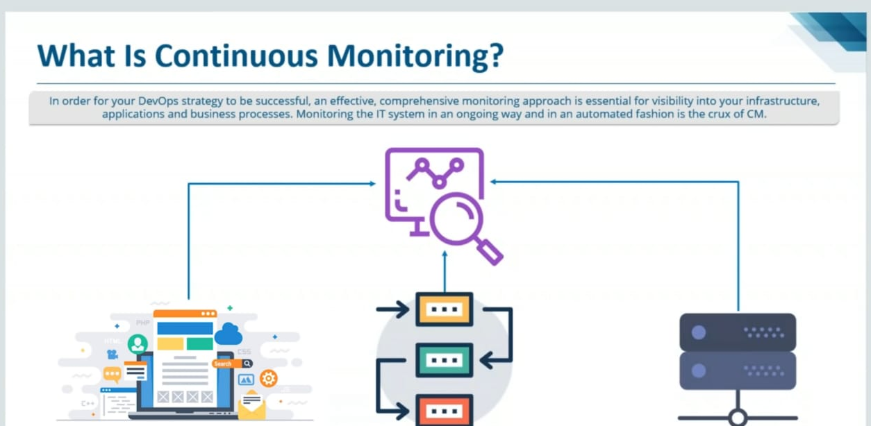
Continuous Monitoring

Slide 4
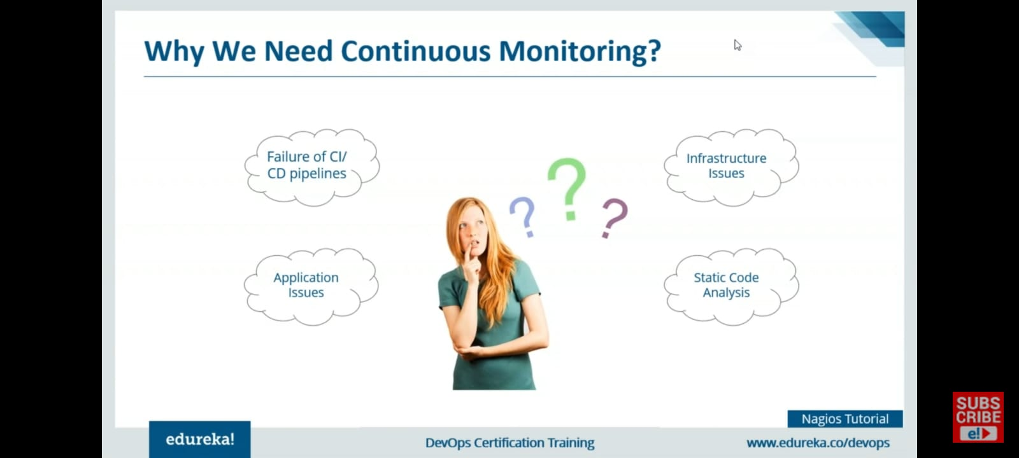
Why Do We Need Continuous Monitoring

Slide 5
What Is 360⁰ Monitoring
360 degree monitoring is a full fledged monitoring provided to the customer server, application, database and network so as to make sure their business is not halted at any cost.

Slide 6
Why 360⁰ monitoring
Get complete visibility into your server health and performance
Frees up your IT resources
Improve end-user experience
Reduce downtime
Boost up Innovation

Slide 7
How?
Centralized Monitoring
Servers push to a centralized collection platform
-> high load of network traffic
-> monitoring can become bottleneck
Decentralized Monitoring
where one considers systems with units of computation that are physically or logically distributed.

Slide 8
TOOLS AND SERVICES WE USED
NAGIOS
ZABBIX
AWS

Slide 9
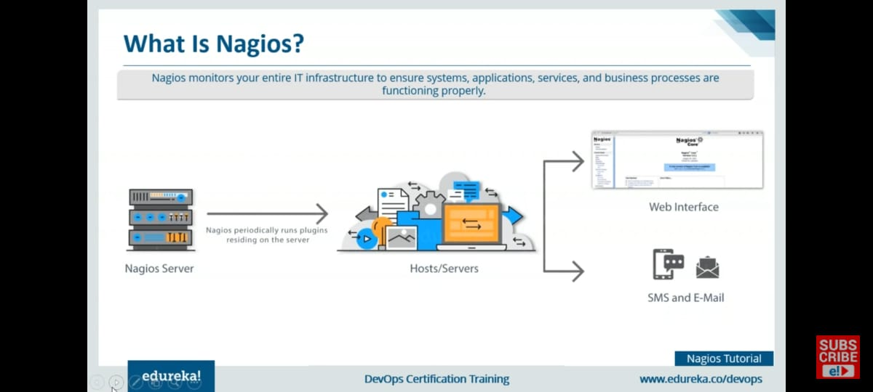
NAGIOS

Slide 10
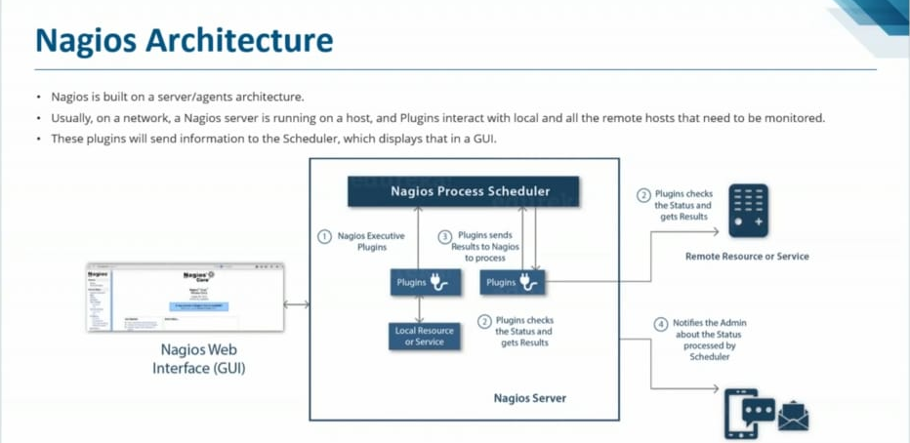
HOW DOES NAGIOS WORK

Slide 11
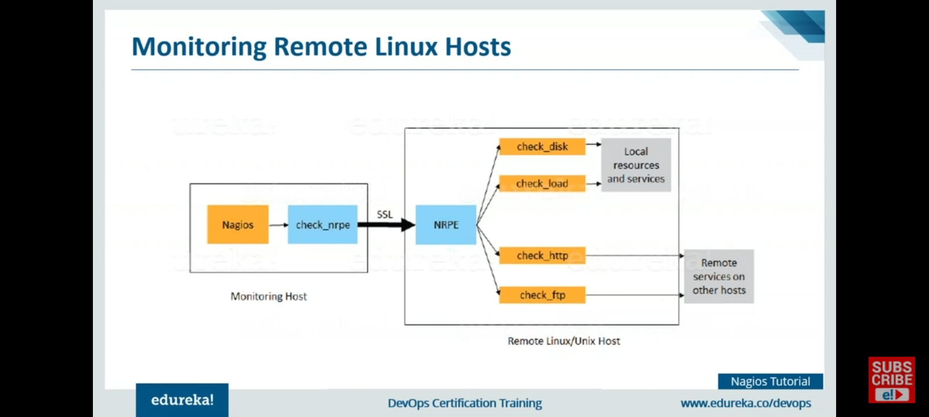

Slide 12
What do we offer
Server Monitoring
Webserser Monitoring
Database Monitoring

Slide 13
Flow of project
Initiated required number of ubuntu 20 linux instances on AWS.
Assign IAM roles for collaborative work.
Assigned elastic IP to all the instances
Installed Nagios on host and remote
Configure plugin and NRPE on every instance.
Edited config file of Nagios to add monitoring according to our need.
Deployed webserver to monitor.
Initiated MySql database to monitor it.
Set up mailing service SMTP for nagios, for alerting the admin incase of any fault.
Installed another open source monitoring tool Zabbix to make decentralised monitoring.
Configure zabbix on remote and host.

Slide 14
Challenges faced throughout.
Challenges
1. Setting up mailing service for Nagios
2. Setting up NRPE
3. Could not assign elastic IPs to all our 7 instances.(as aws only allows 5)
4. Had to face compatibility issues with OS
How we handled them
1. Did it through trial and error and official documentation.
2. Gone through various CLI logs.
3. Had to contact to AWS support team.
4. Tried on multiple OS to troubleshoot.

Slide 15
Why Not AWS Cloudwatch
Although using cloud watch would been more easier as our project is totally hosted on AWS, but we choose not to use it because:
1.Cloud watch is centralized and could become slow when there are multiple push request from many services.
2.Wanted to learn open source tool that are industry relevant.
3. Cloud watch is very expensive when compared to open source tools like nagios an zabbix which are 100 percent free.

Slide 16
THANK YOU

